Slide 1

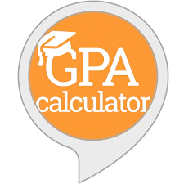
GPA CALCULATOR
Calculate Your GPA with Ease - Your Academic Success, One Click Away!

Slide 2
INTRODUCTION
The project aims to develop a web application for analyzing student performance based on internal exam scores.
It helps students identify weak areas and suggests improvements to achieve better grades in final exams.

Slide 3
EXISTING SYSTEM
Traditional methods involve manual calculation and analysis of student performance, which is time-consuming.
Present GPA Calculators does not provide Student feedback and improvement suggestions.
Feedback is often delayed, as it depends on teacher availability and manual review of scores.

Slide 4
ADVANTAGES
Personalized teacher feedback can provide nuanced understanding and motivation.
Does not rely on technology, making it accessible without internet or devices.
DISADVANTAGES
Manual processes are prone to human error and can be inconsistent in providing feedback.
Time delays in receiving feedback may hinder timely improvements in student performance.

Slide 5
PROPOSED SYSTEM
The system allows students to input their internal exam scores such as CAT marks , Assignment marks and their model practical marks and receive detailed performance analysis.
It provides notifications on required improvements and suggests target scores for achieving desired GPAs.

Slide 6
ADVANTAGES
The application offers personalized feedback, helping students focus on areas needing improvement.
Automated analysis and notifications save time and provide consistent insights.
DISADVANTAGES
The system relies on accurate data input; incorrect entries could lead to misleading analysis.
It requires internet access, limiting usability in areas with poor connectivity.

Slide 7
FUNCTIONAL REQUIREMENTS :
User Authentication: Secure login and logout with email ID.
Marks Input: Enter and validate marks for up to three internal exams.
Performance Analysis: Identify weak areas and suggest improvements.
GPA Calculation Guidance: Provide feedback on scores needed for target GPA.
Notifications: Send performance updates and improvement suggestions.
NON FUNCTIONAL REQUIREMENTS:
Security: Ensure data privacy and secure access.
Usability: User-friendly interface for ease of use.
Performance: Efficient operation with quick response times.
Reliability: Consistent availability and accurate calculations.

Slide 8
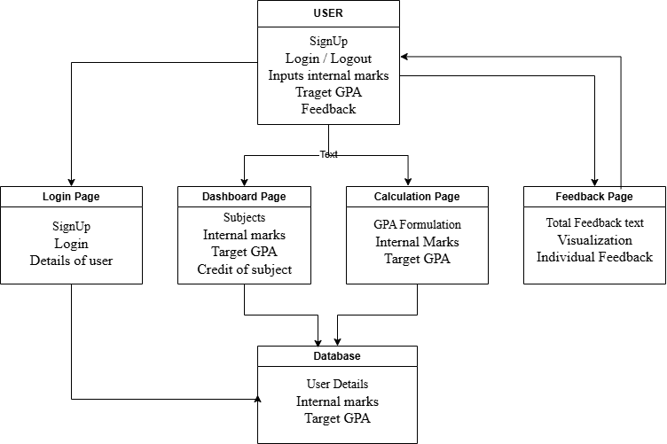
ARCHITECTURE DIAGRAM:

Slide 9
ARCHITECTURE DIAGRAM EXPLANATION:
The architecture of this GPA analysis web application consists of five main components. The User interacts with the system by signing up, logging in, and providing internal marks. The Login Page enables new users to sign up and existing users to log in. The Dashboard Page collects information about subjects, internal marks, and subject credits. The Calculation Page processes these inputs using GPA formulas to evaluate performance. Finally, the Feedback Page provides personalized feedback through text.

Slide 10
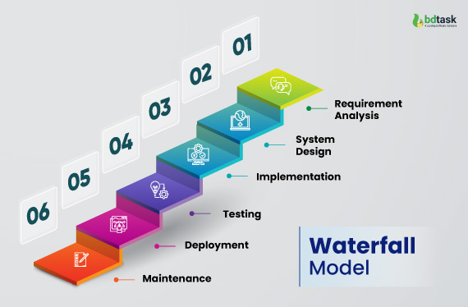
WATERFALL MODEL:
The Waterfall Model is a linear and sequential approach that consists of several phases.
The GPA Analysis Web Application project follows the Waterfall Model, which ensures a structured and sequential development process. In the Requirements Phase, we gathered detailed requirements for login, marks input, GPA calculations, and feedback. The Design Phase focused on creating a clear architecture and choosing technologies. During Implementation, each module, from authentication to GPA analysis, was developed individually. This was followed by Integration and Testing to verify that all components worked together seamlessly.

Slide 11
TESTING (UNIT TESTING)
Unit testing is a technique used to verify that individual parts of a program function as expected. In your GPA calculator project, unit tests are essential for ensuring accuracy in key functions, such as `calculateSubjectInternal`, `updateCourses` and `populateSubjects`, which handle GPA calculations and internal exam breakdowns. These tests confirm that calculations are correct under various scenarios, like perfect grades or different credit distributions, verifies the calculation of internal GPA contribution based on given inputs, ensures subjects are correctly populated into the container and tests whether the course dropdown is populated correctly based on the regulation selection.This accuracy is crucial, as incorrect GPA calculations could lead to misleading feedback for students. By isolating and testing each function, unit testing helps detect errors early, improves code reliability, and allows safe modifications to the project over time. Overall, unit testing ensures that the feedback provided to students is accurate and dependable.

Slide 12
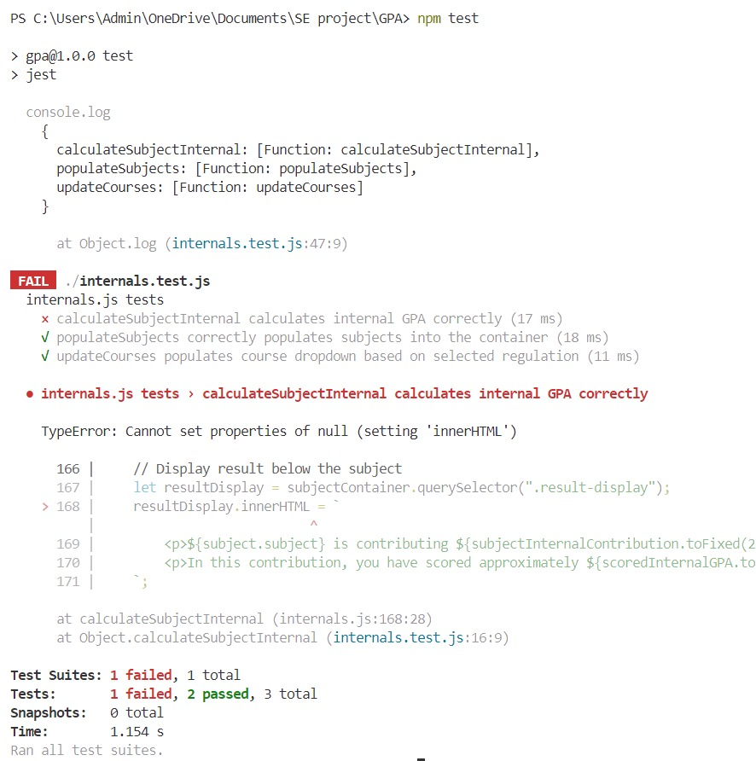
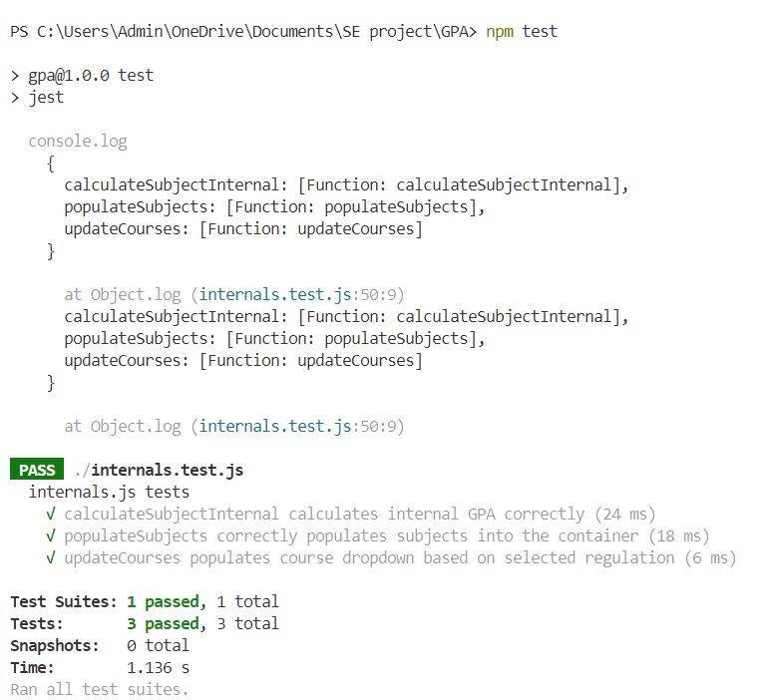
TESTING OUTPUTS:

Slide 13
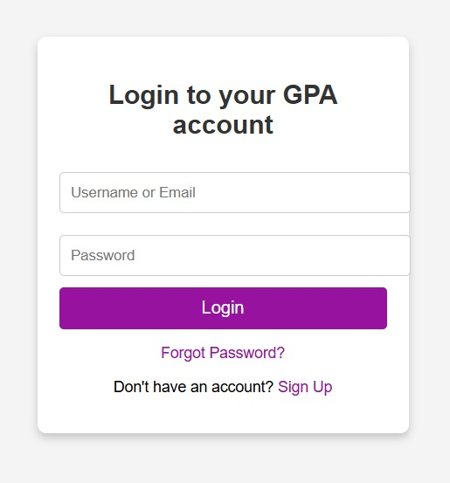
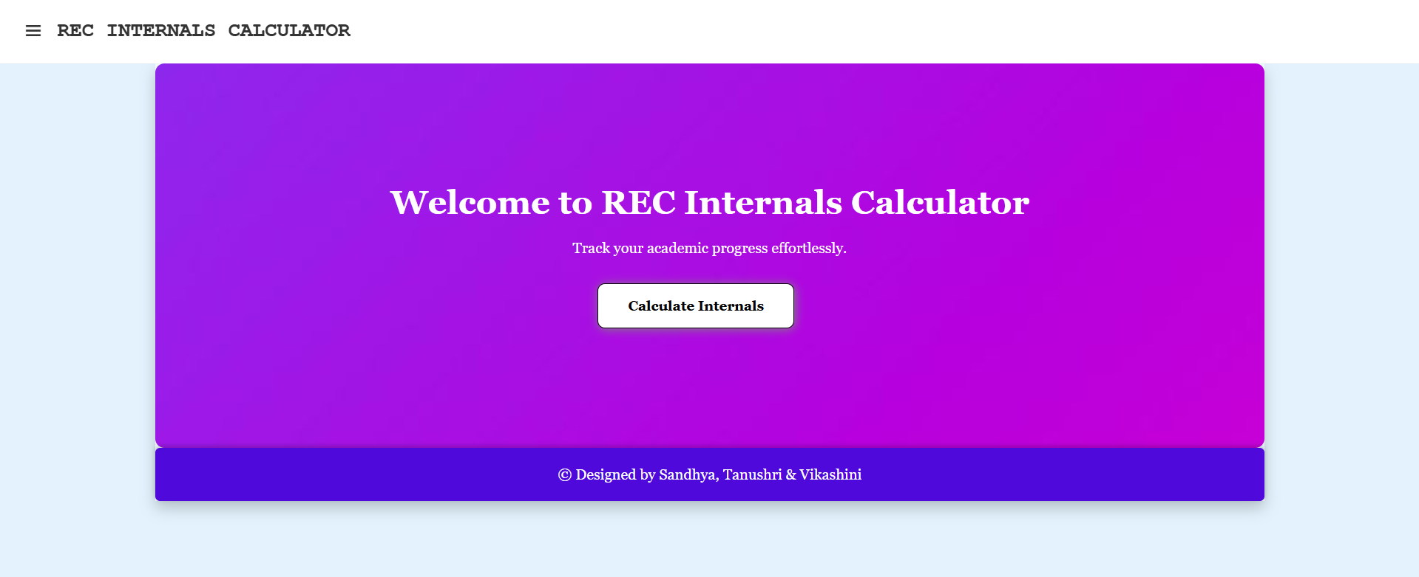
OUTPUT SCREENSHOTS:

Slide 14
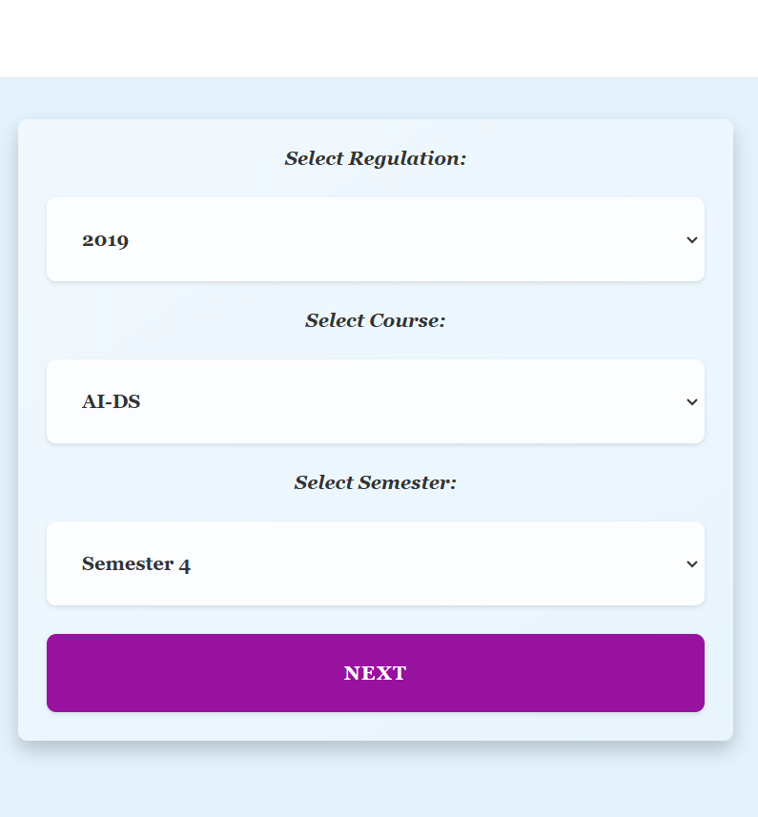
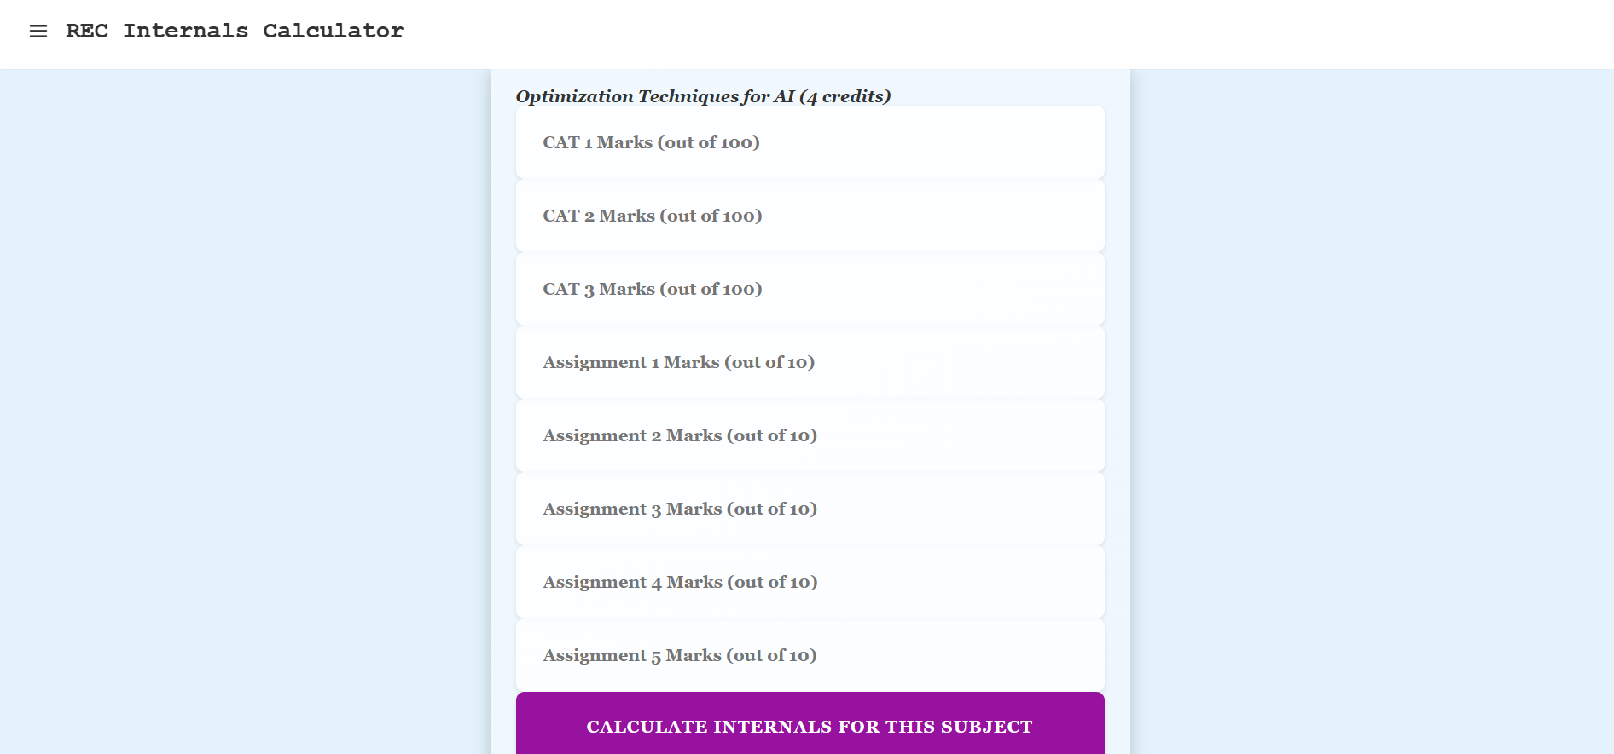
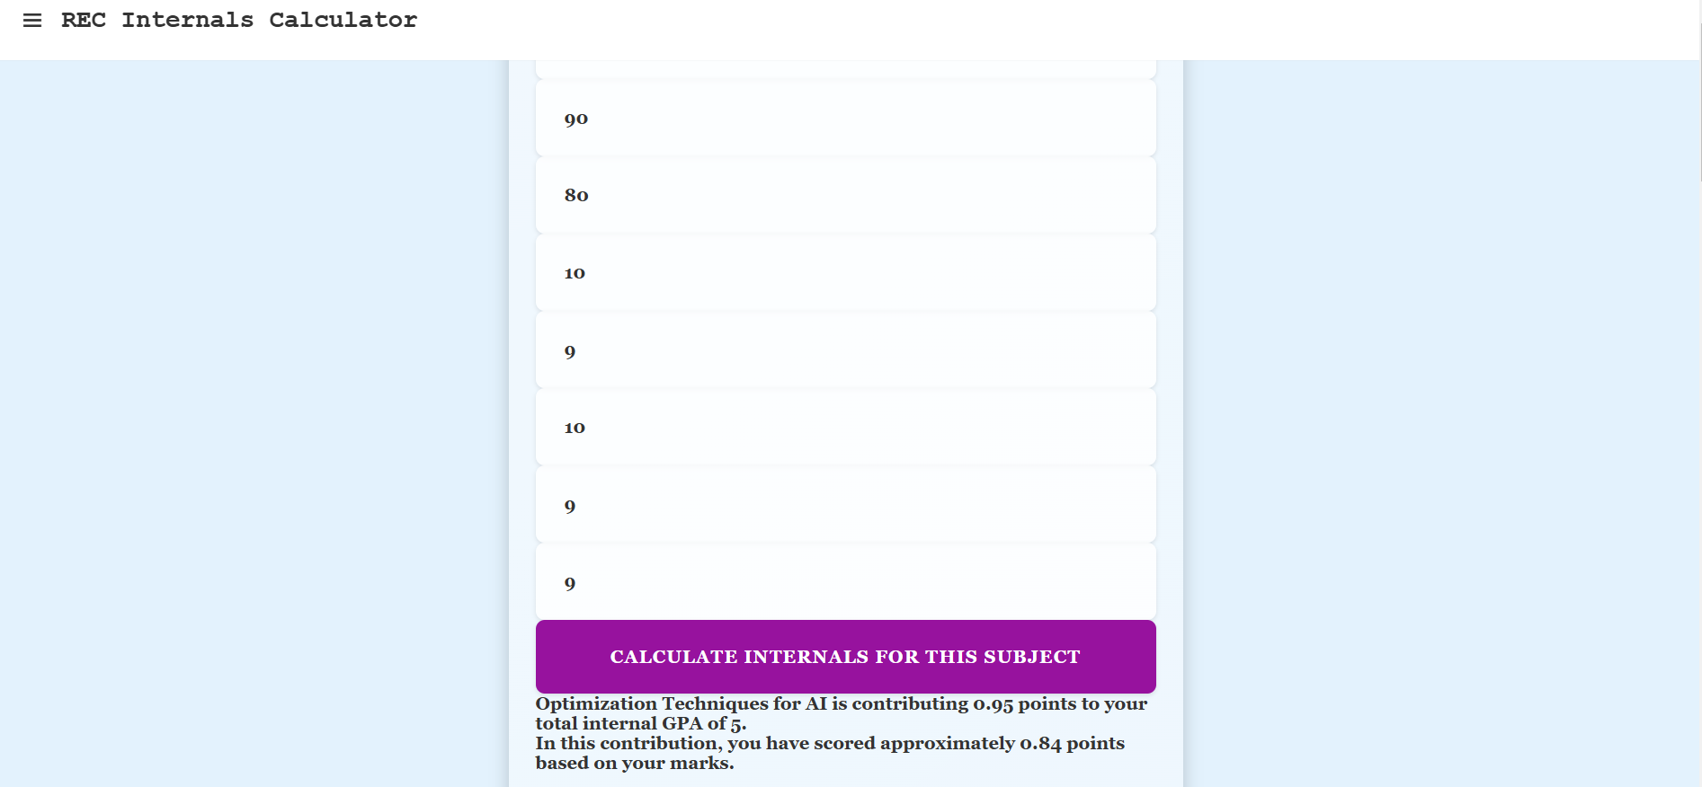

Slide 15


Slide 16
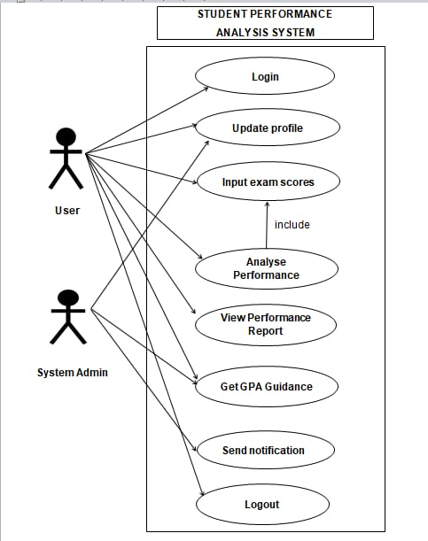
USE CASE DIAGRAM
The diagram outlines the various use cases associated with the system, showing how both actors interact with the system to accomplish different tasks. The central focus is on the analysis of student performance, including the input and assessment of exam scores, generating reports, and providing guidance based on input scores.

Slide 17
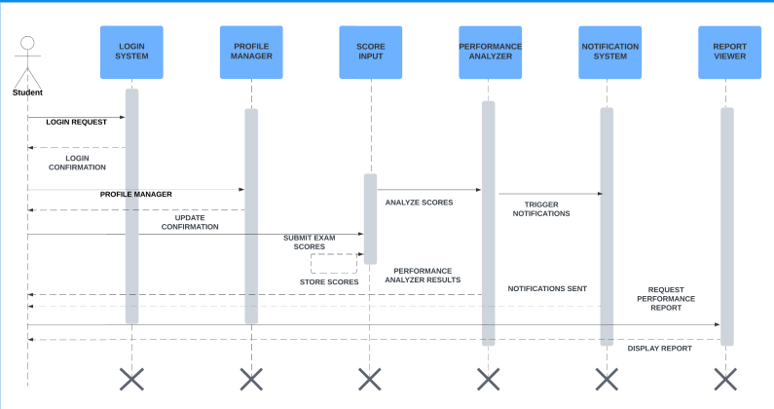
SEQUENCE DIAGRAM
The Sequence Diagram for the "Student Performance Analysis System" illustrates the step-by-step interaction between a student and the system components. It begins with the student logging in, followed by profile updates and score submission. The system then analyzes the scores, triggers notifications, and finally displays the performance report .

Slide 18
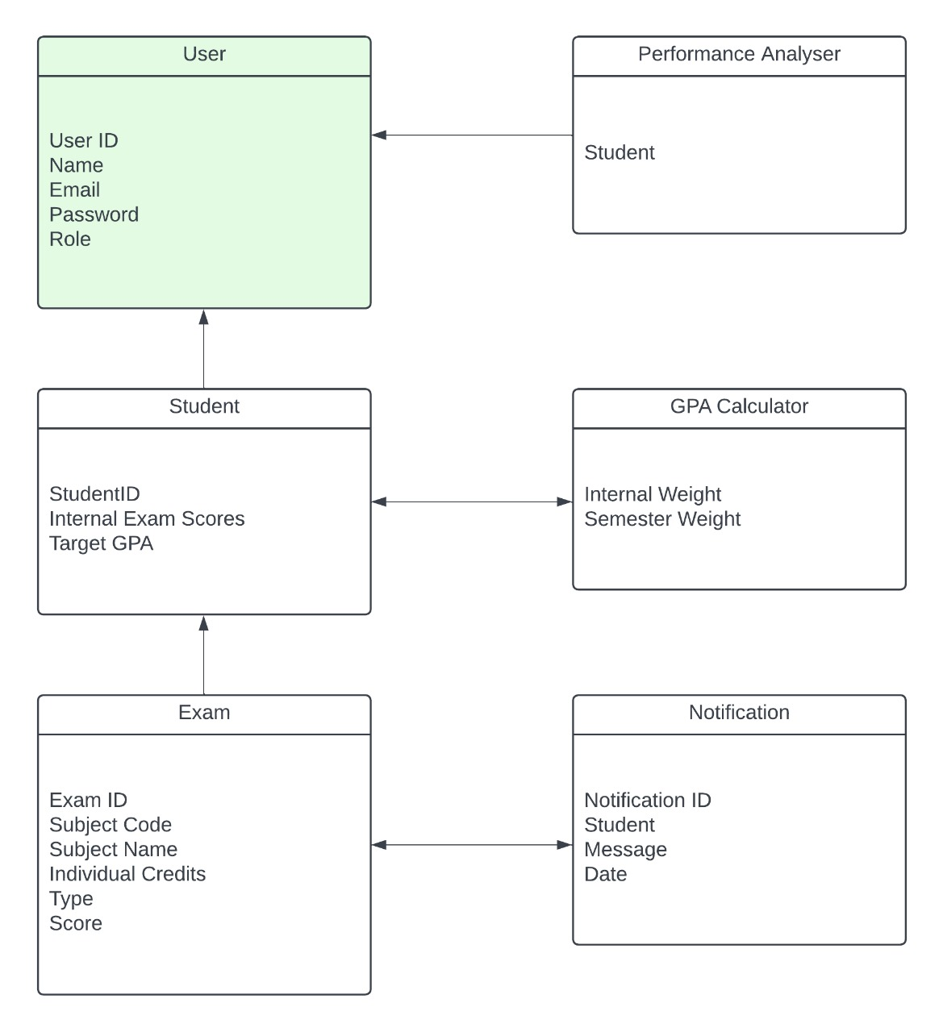
CLASS DIAGRAM
The class diagram illustrates the relationships between different entities in a student performance analysis system. The main classes include User, Student, Exam, Performance Analyser, GPA Calculator, and Notification. These classes manage student data, exam details, performance analysis, GPA calculation, and notifications, with attributes such as `User ID`, `Student ID`, `Exam Scores`, and `Notification ID` defining their roles and connections within the system.

Slide 19
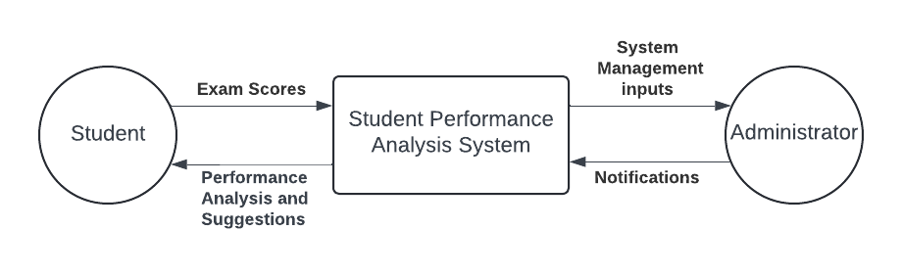
DATA FLOW DIAGRAM
LEVEL 0

Slide 20
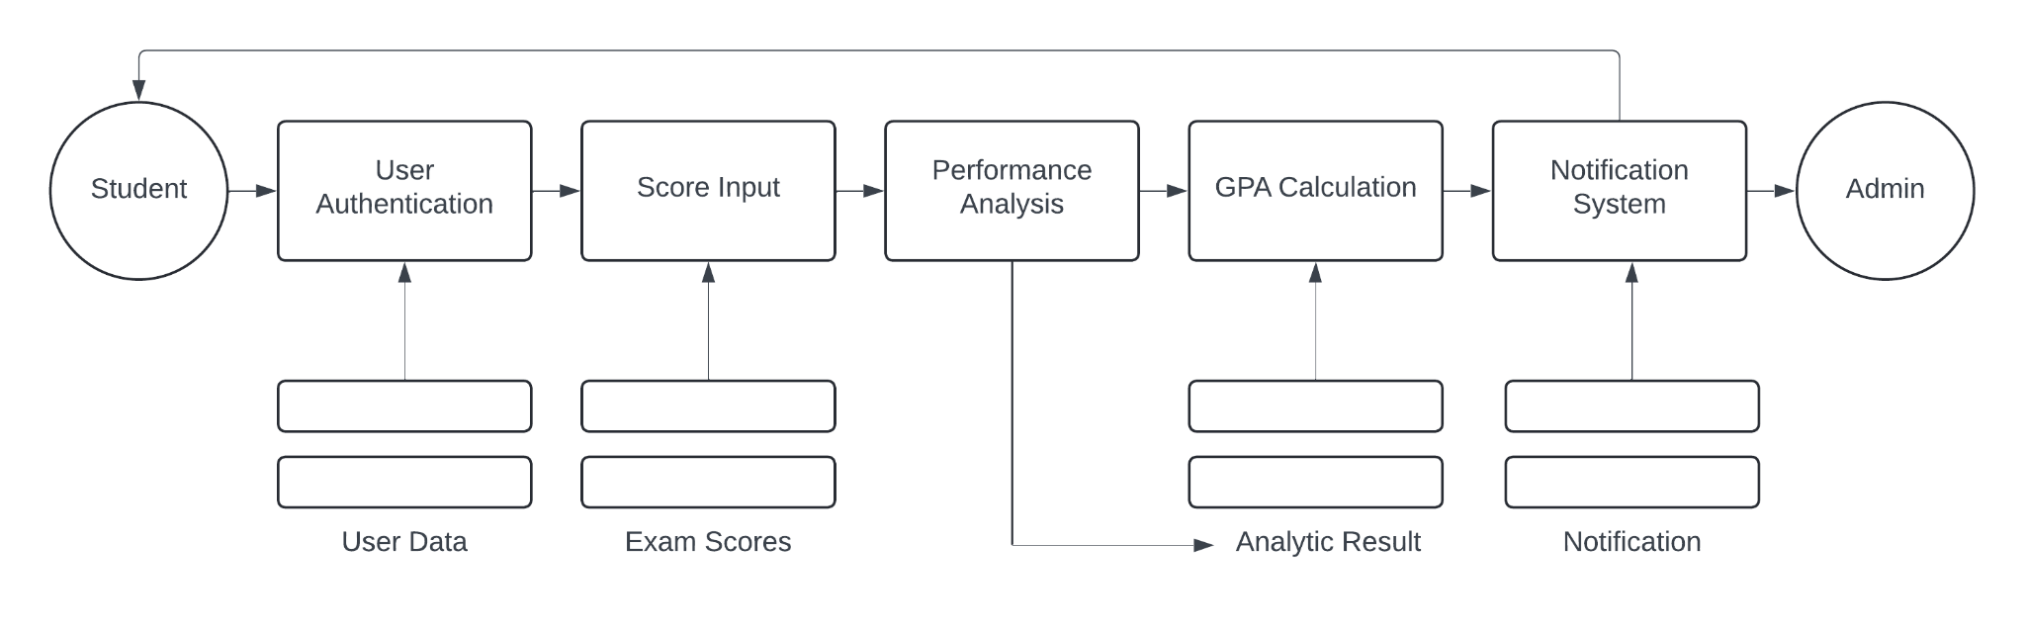
DATA FLOW DIAGRAM
LEVEL 1

Slide 21
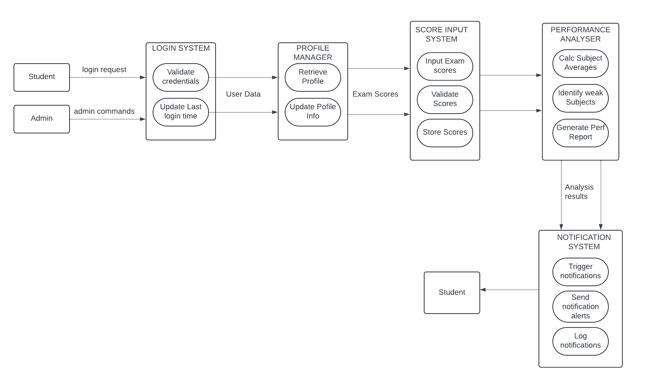
DATA FLOW DIAGRAM
LEVEL 2

Slide 22
RESULTS AND DISCUSSIONS:
The GPA Analysis web application successfully provides students with insights into their academic performance by analyzing internal exam marks and obtaining feedback based on their inputs to achieve their target scores. The dashboard enables flexible input for any number of subjects, ensuring adaptability to various curricula. The feedback generated includes personalized suggestions, empowering students to focus on subjects where improvement is needed. Testing validated the application's functionality, confirming accurate GPA calculations and secure login processes. Discussions indicate that this tool is beneficial for academic self-assessment, guiding students toward enhanced semester performance.

Slide 23
FUTURE SCOPE:
This project could be expanded by integrating predictive analytics to forecast GPA trends based on historical data, helping students set realistic goals. Adding support for teachers to provide direct feedback on student progress could further personalize the learning experience. Additional modules for tracking attendance and extracurricular performance would create a more comprehensive student profile. Mobile app compatibility would allow easier access, and data anonymization techniques could make the tool applicable across multiple educational institutions, aiding administrators in assessing student performance trends on a larger scale.

Slide 24
CONCLUSION:
The GPA Analysis web application is a valuable tool that addresses the need for academic self-assessment among students. By consolidating internal marks and delivering feedback, it empowers students to understand their strengths and areas needing improvement. Implemented with the Waterfall model, this project went through systematic phases, ensuring reliability and functionality. The user-friendly design and informative visual feedback contribute to enhancing the academic experience, preparing students better for their semester exams. Overall, this project highlights the potential of technology in fostering educational growth and student empowerment.

Slide 25
REFERENCES:
1. Balachandran, V., & Radhakrishnan, V. (2019). Educational Data Mining for Student Performance Prediction. Journal of Educational Technology.
2. Gupta, P. (2020). Flask Web Development: Developing Web Applications with Python. O'Reilly Media.
3. Kumar, A., & Singh, R. (2021). Predictive Analytics in Academic Performance. International Journal of Education and Research.
4. Sharda, R., & Delen, D. (2017). Business Intelligence and Analytics. Pearson Education.
5. Pedregosa, F., et al. (2011). Scikit-learn: Machine Learning in Python. Journal of Machine Learning Research.
6. Flask Documentation. (n.d.). Retrieved from https://flask.palletsprojects.com/
7. SQLAlchemy Documentation. (n.d.). Retrieved from https://www.sqlalchemy.org/
8. Matplotlib Documentation. (n.d.). Retrieved from https://matplotlib.org/
9. Jain, P., & Bansal, R. (2022). Advancements in Data Visualization for Educational Analytics. Educational Data Journal.
10. Dhir, P. (2018). Feedback Mechanisms in Digital Learning. Learning Analytics Journal.

Slide 26
THANK YOU

